Slide 1
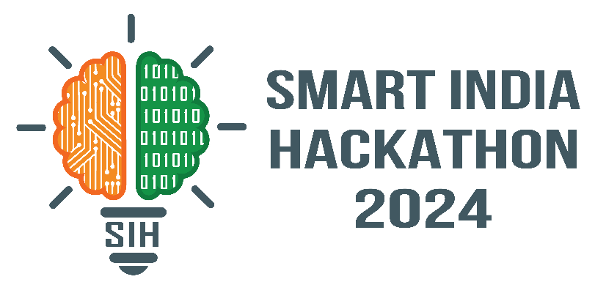
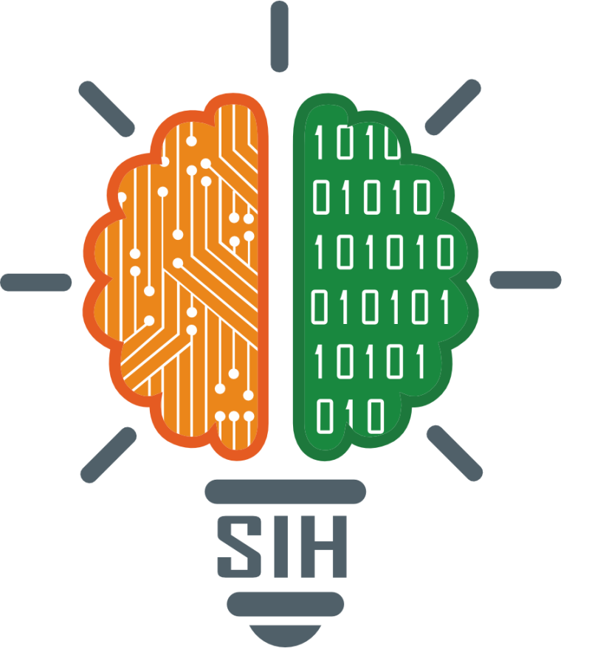
SMART INDIA HACKATHON 2024
Problem Statement ID - SIH1716
Problem Statement Title - Indian Sign Language to Text/Speech translation
Theme - Miscellaneous
PS Category - Software
Team ID - PIC2024-SW-58
Team Name - HandSpeak Dynamos

Slide 2
INDIAN SIGN LANGUAGE TO TEXT/SPEECH TRANSLATION
HandSpeak Dynamos
Problem Statement
Blind, deaf and hard-of-hearing individuals in India face significant communication barriers due to the lack of effective tools to translate Indian Sign Language (ISL) into text and speech.
Existing solutions are limited, and there is a need for a comprehensive software that can accurately recognize and translate ISL gestures into text and spoken language in real-time, into multiple regional languages.
Proposed Solution
The solution aims to develop a real-time translation system that converts ISL signs and gestures into text and speech, enabling seamless communication between the deaf and hard-of-hearing community and the hearing world.
The software will be capable of recognizing and interpreting a comprehensive library of ISL signs and gestures, and provide accurate text and speech output in multiple Indian languages.
The existing solution is that, the signs are captured by only the hand gestures, each gesture containing the sign of a single/particular letter. The uniqueness which we are bringing into innovation is that, the gestures will be containing the sign of the words or a phrase/sentence, interpreting and recognizing the whole body gesture.

Slide 3
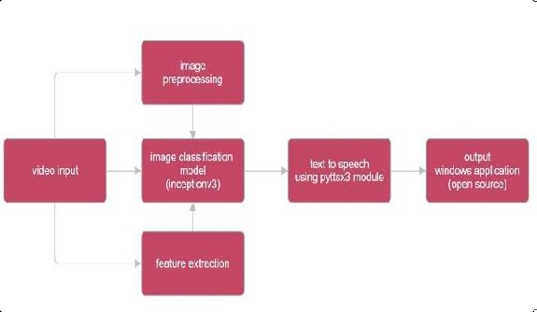
TECHNICAL APPROACH
HandSpeak Dynamos
Python Frameworks:
TensorFlow - For building and training the Convolution Neural Networks (CNNs).
OpenCV - For capturing video input and preprocessing images, enhancing gesture recognition, hand
detection and using separation techniques, levarging computer vision library, helping the
system isolate hand movements, ensuring accurate identification even in cluttered
backgrounds or low-light conditions.
3. MediaPipe - For hand and body skeleton tracking.

Slide 4
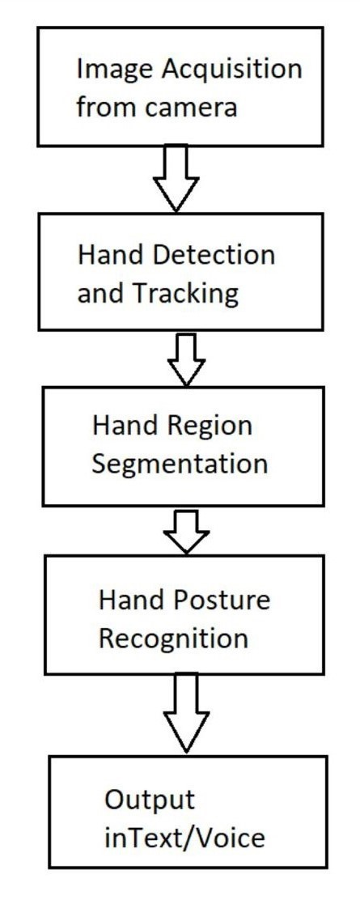
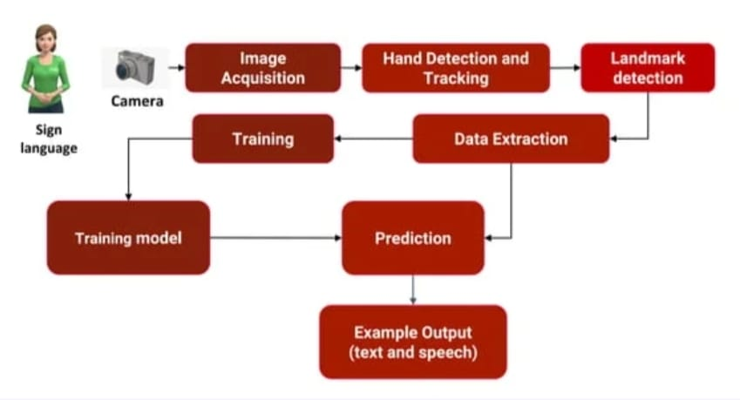
TECHNICAL APPROACH
HandSpeak Dynamos
4. Flask - For deploying the solution as a web application.
5. InceptionV3 - For Image classification mode, well-suited for
detecting both static and dynamic gestures in video frames.
6. Text-To-Speech - For converting text to speech using
TTS engines. The system will be integrated with popular APIs
like Google’s TTS API or open-source libraries like pyttsx3.
7. TensorRT - For optimizing the code for efficient model inference,
ensuring minimal lag during live conversations.
@SIH Idea submission- Template

Slide 5
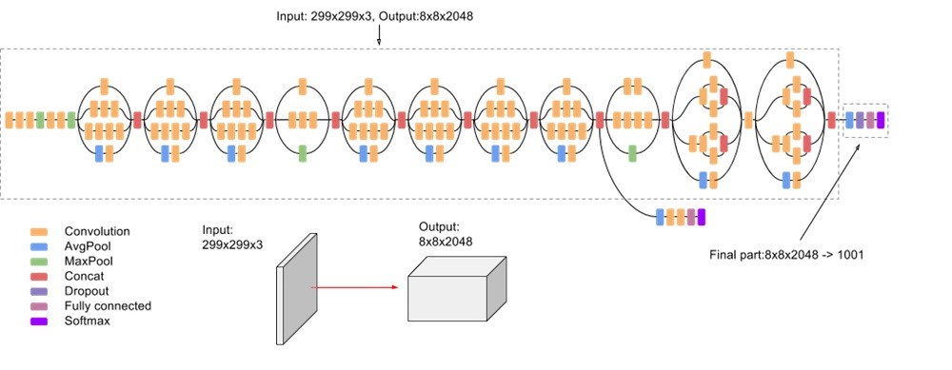
TECHNICAL APPROACH
HandSpeak Dynamos
Machine Learning Models:
CNNs - For image classification and gesture recognition.
Long Short-Term Memory (LSTM) - For sequence prediction and handling temporal data, especially for gestures that involve movement over time.
Large Language Models (LLMs) - For generating more complex or contextualized text outputs from recognized gestures
@SIH Idea submission- Template

Slide 6
FEASIBILITY AND VIABILITY
HandSpeak Dynamos
FEASIBILITY: VIABILITY:
1. Accurate sign recognition
and translation.
2. Requires collaboration with ISL
experts, data collection, and
annotation.
3. Addresses a significant social
need, promotes inclusivity
and accessibility.
1. Growing demand for
accessible technologies
potential for government
and corporate adoption.
2. Significant positive impact on ISL
users' lives, promotes social
inclusion and accessibility.
3. Potential for scalability
through cloud-based
infrastructure and digital
distribution.
@SIH Idea submission- Template

Slide 7
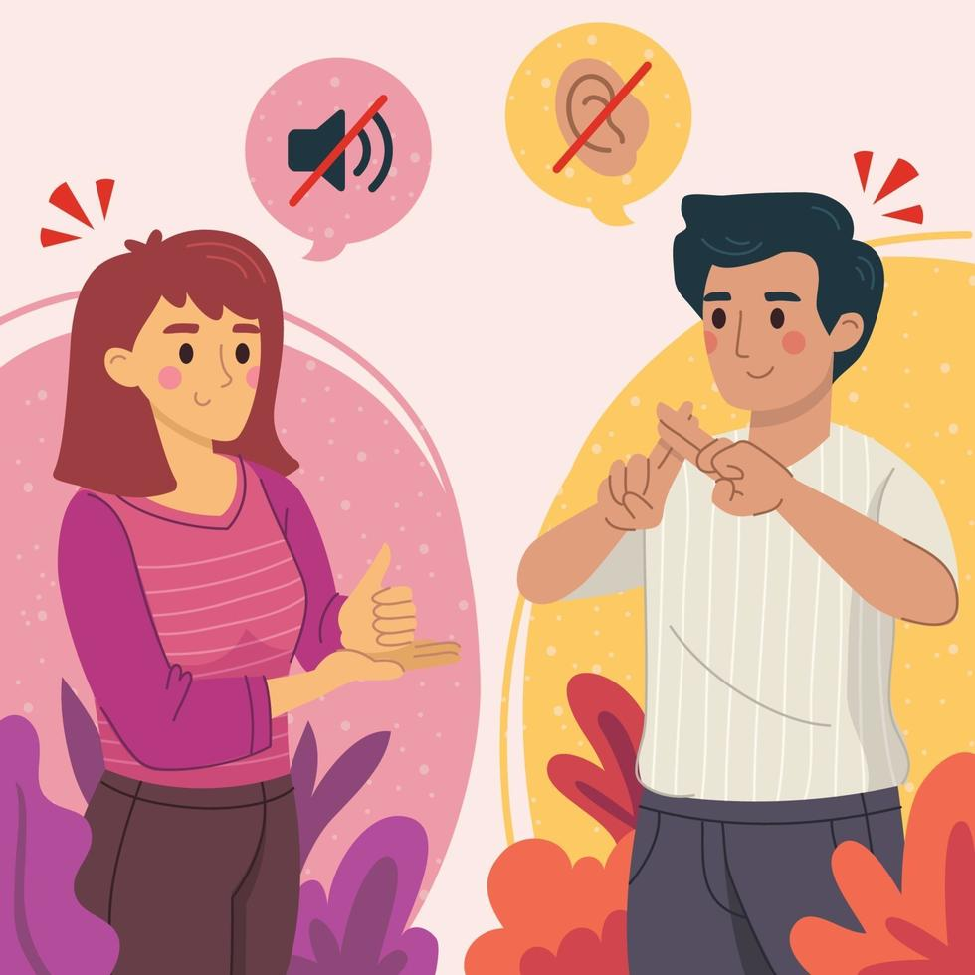
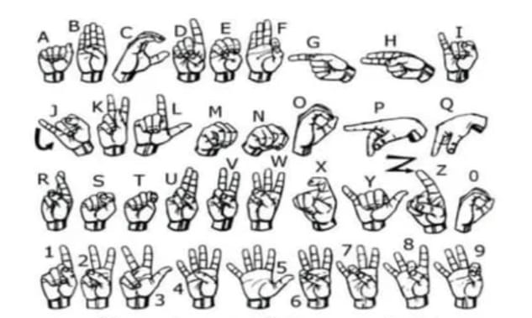

FEASIBILITY AND VIABILITY
HandSpeak Dynamos
Data Collection
Using pre-existing datasets.
Recording and collecting videos of different ISL gestures.
Annotating the data with corresponding labels.
Preprocessing
Skeleton Tracking - Using MediaPipe to extract hand and body key points from the video.
Image Processing - Resizing, normalizing, and applying data augmentation techniques.
@SIH Idea submission- Template

Slide 8
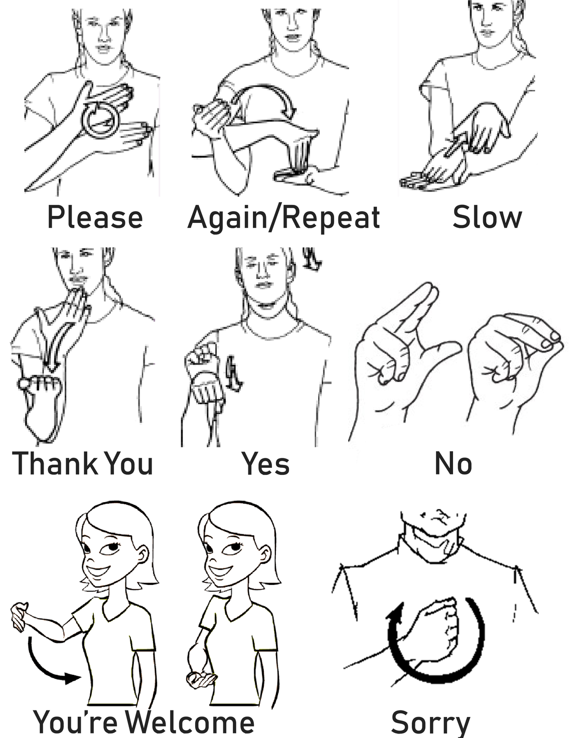
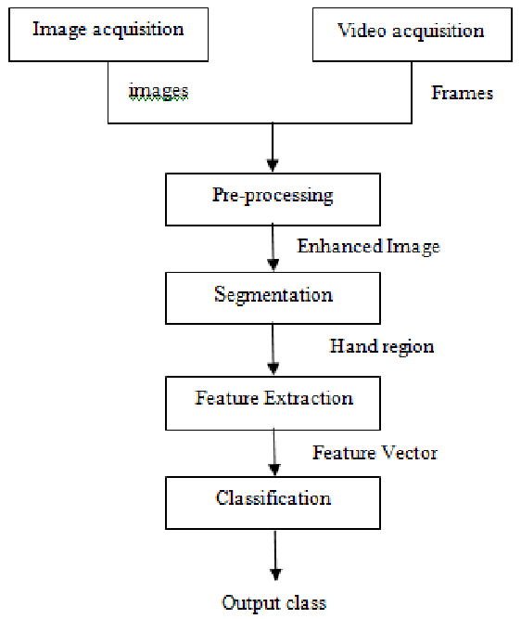
FEASIBILITY AND VIABILITY
HandSpeak Dynamos
3. Model Training
CNN Model - Training the CNN model on the pre-processed images for gesture recognition.
LSTM Model - Integrating LSTM to recognize sequences of gestures for full-body gestures or gestures involving motion.
4. Model Evaluation
Evaluating the model’s accuracy using validation datasets.
Fine-tuning hyperparameters and performing model optimization.
@SIH Idea submission- Template

Slide 9
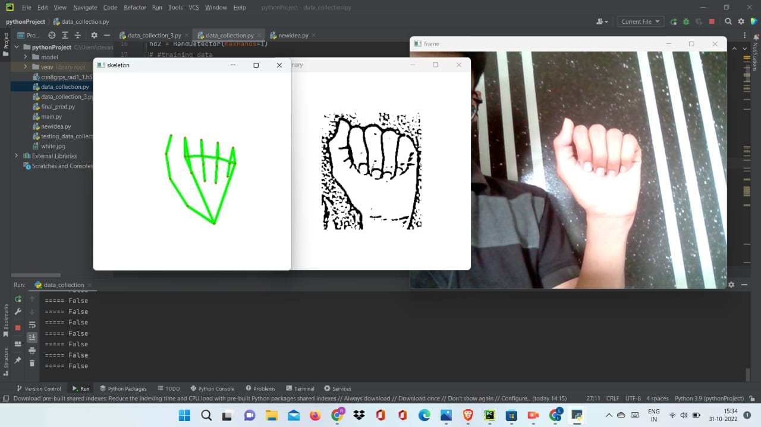
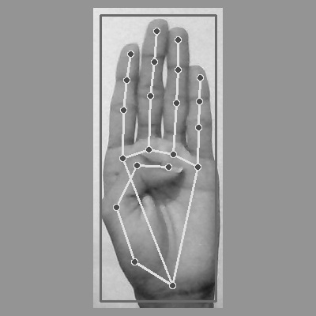
FEASIBILITY AND VIABILITY
HandSpeak Dynamos
5. Implementation
Integrating the trained model into a real-time application.
Using OpenCV to capture video input.
Deploying the model to classify gestures and converting
them into text.
Using Text-to-Speech (TTS) systems to convert the recognized
text into speech in multiple Indian languages.
6. Skeleton Tracking
Utilizing MediaPipe for detecting and tracking key points of the body,
especially focusing on the hands and face.
The skeleton tracking system enhances gesture recognition by providing
more data points beyond simple image classification.
7. Incorporating LLMs
Using LLMs like GPT-4 to generate more contextualized and fluent text
from the recognized gestures.
This can help in scenarios where gestures could have multiple meanings
depending on the context
8. Real-Time Processing
For the system to be effective and to process gestures quickly and respond in real-time, we maximize hardware performance by utilizing GPUs, enabling faster computation.
@SIH Idea submission- Template

Slide 10
IMPACT AND BENEFITS
HandSpeak Dynamos
Potential Impacts on the Target Audience:
Breaks down language barriers, enabling ISL users to communicate with non-signers.
Facilitates access to education, employment, healthcare, and government services.
Fosters social inclusion, building relationships and connections with the broader community.
Boosts confidence and independence, enabling ISL users to navigate everyday situations more easily and building connections with the broader community.
Benefits of the Solution:
Increases job opportunities, enabling ISL users to participate in the workforce.
Reduces costs associated with interpreters and translation services.
Minimizes the need for physical interpreters, reducing travel-related emissions.
Promotes digital literacy and access, bridging the digital divide.

Slide 11
CONCLUSION
HandSpeak Dynamos
The Indian Sign Language to Text/Speech translation software represents a critical step toward bridging the communication gap between the blind, deaf and hard-of-hearing community and the hearing world.
By offering a real-time, accurate, and user-friendly solution, the software empowers ISL users to navigate everyday life with ease, ultimately fostering inclusivity, independence, and equal opportunities for the public, and even in the fields education, employment, healthcare, and government services.
The software will be capable of recognizing and interpreting a comprehensive library of ISL signs and gestures, and provide accurate text and speech output in multiple Indian languages.
The uniqueness which we are bringing into innovation is that, the gestures will be containing the sign of the words or a phrase/sentence, interpreting and recognizing the whole body gesture.
Through ongoing collaboration with the deaf community and continuous technological advancements, this project has the potential to make a lasting, positive impact on millions of lives across India.
@SIH Idea submission- Template

Slide 12
RESEARCH AND REFERENCES
HandSpeak Dynamos
https://indiansignlanguage.org/
M. Elmahgiubi, M. Ennajar, N. Drawil and M. S. Elbuni, "Sign language translator and gesture recognition," 2015 Global Summit on Computer & Information Technology (GSCIT), Sousse, Tunisia, 2015, pp. 1-6, doi: 10.1109/GSCIT.2015.7353332.
PriyankaR. Potdar, D.M. Yadav Dr.Innovative Approach for Gesture to Voice Conversion
Kaur, B., Chaudhary, A., Bano, S. et al. Fostering inclusivity through effective communication: Real-time sign language to speech conversion system for the deaf and hard-of-hearing community. Multimed Tools Appl 83, 45859–45880 (2024). https://doi.org/10.1007/s11042-023-17372-9
C. Szegedy, V. Vanhoucke, S. Ioffe, J. Shlens and Z. Wojna, "Rethinking the Inception Architecture for Computer Vision," 2016 IEEE Conference on Computer Vision and Pattern Recognition (CVPR), Las Vegas, NV, USA, 2016, pp. 2818-2826, doi: 10.1109/CVPR.2016.308.

